Slide 1
SBFT STF/SCB Training
Enrique Santillan

Slide 2
STF General Info
STF (Structural Test Fabric)
Develop at intel
Converge DFT from different teams
Reference
https://intel.sharepoint.com/sites/10nmcon/CHASSIS/DFx/Shared%20Documents/DFT%20SIP%20Docs/Structural%20Test%20Fabric%20HAS%20rev082.pdf
Source Text 10pt IntelOne Display Regular

Slide 3
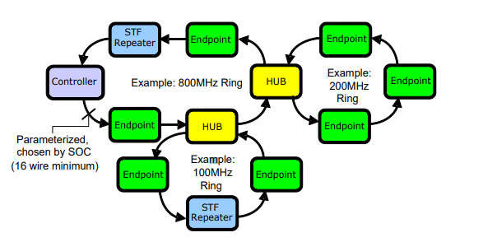
STF Overview
Unidirectional rings-based topology.
Elements:
Repeaters (Retiming )
Endpoints (Destination)
Hub (Bridge over rings)
Controller (Interface to pins)
Source Text 10pt IntelOne Display Regular

Slide 4
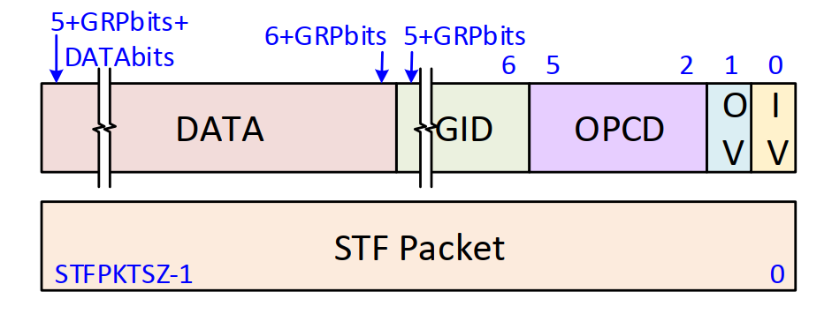
STF Packet format
Fields:
IV (Input Valid)
OV (Output Valid)
Opcode (Operation to perform)
GID (Group ID)
Programable ID of who I want as destination.
Data
Source Text 10pt IntelOne Display Regular

Slide 5
What’s an STF Endpoint
How do we write an STF register:
Example: Write RegisterB with 0x30
Send the SELECT:
SELECT as GID5 to PID 0x60.
00000000000000000000000001100000 0101 0100 01
Send the CONTROL:
CONTROL as 0x1 to GID5.
00000000000000000000000000010000 0101 1010 01
Send the DATA:
DATA as 0x30 to GID5.
00000000000000000000000000110000 0101 1011 01

Slide 6
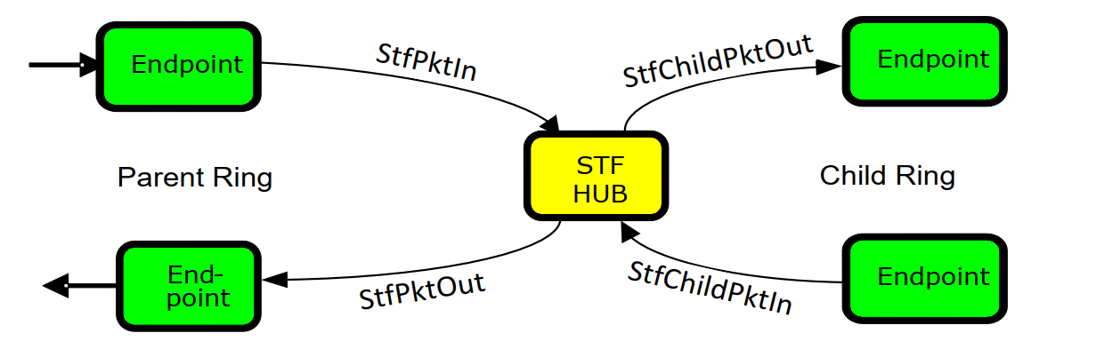
What’s an STF HUB
It’s a bridge between 2 rings.
Can filter the pkts from the parent to child (Input) or from child to parent(output).
Pop N Forw:
HUB it’s “smart”
HUB replicates the pkt and send it to child and parent.
From parent to child Hub checks that the child has the GID of the pkt available.
From child to parent hub checks that the pkt is valid and it’s not a replication.
Bypass
HUB doesn’t send anything thru the child ring.
Serial:
Everything on the parent the HUB send it to the child without replication.
No checks from latency.

Slide 7
STF HUB Pop N Forward (Parallel) (Not used anymore)
There’s an incoming on the parent input
The pkt gets replicated between the parent and the child (parallel).
The child pkt eventually returns.
Option 1:
The pkt is the same as before so it’s dumped.
Option 2:
The pkt has a response so it should go thru hub to the parent ring.
STF PKT
STF PKT
STF PKT
STF PKT
STF PKT
How does the HUB knows what to dump?
The HUB considers a different amunt of factors to decide if the pkt should flow to the parent or not or not:
OV it’s asserted.
The forwarding table has the GID as a response valid.
The trackers delay match the pkt delay.

Slide 8
STF HUB Other configurations
Serial
Bypass

Slide 9
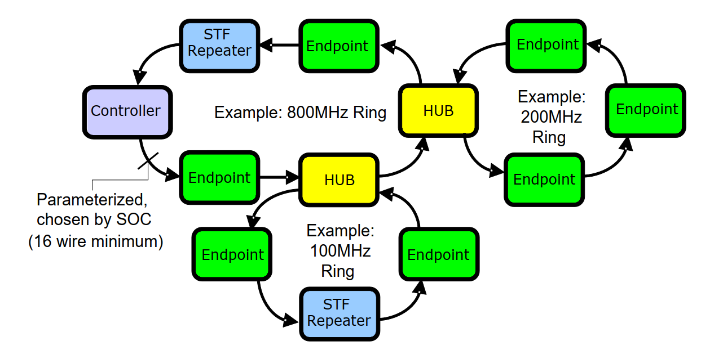

How should I configure STF network to reach an endpoint
Let’s say we want to talk to the endpoint in the red circle.
1. Configure needed HUBs GID.
Select to HUB as GID1.
2. Configure HUB GID tables.
Control/Data to Rsp/Req tables to GID1. Also here we configure delays.
3. Configure not needed HUBs GID.
Select to HUB as GID3. (Optional)
4. Set HUB as bypass. (Optional)
Control/Data to GID3 to bypass.
5. Configure the EP GID.
Select to EP as GID2

Slide 10
What’s ScoreBoard
Summary:
It’s a special STF endpoint.
His main capability it’s a register where you can write a 1/0 as a “pass/fail” mechanism for different endpoints.
Default it’s 0, so pass until prove to fail. (Could change in future)
The replaces moves the “agent id” from the agent to the scoreboard endpoint if the endpoint has the mismatch on 1.

Slide 11
ScoreBoard Example:
Program EP GIDs.
(Just send selects)
GID 5 to PID 1:
00000000000000000000000000000001 0101 0100 01
GID 6 to PID 2:
00000000000000000000000000000010 0110 0100 01
GID 6 to PID 3:
00000000000000000000000000000011 0110 0100 01
GID 10 to PID 4:
00000000000000000000000000000100 1010 0100 01

Slide 12
ScoreBoard Example:
Program specific Agent_ID per EP.
(Let’s assume CONTROL for agent id = 0x10)
AGENT ID 0x5 to GID 0x5:
00000000000000000000000000010000 0101 1010 01
00000000000000000000000000000101 0101 1011 01
AGENT ID 0x7 to GID 0x6:
00000000000000000000000000010000 0110 1010 01
00000000000000000000000000000111 0110 1011 01
AGENT ID 0x4 to GID 0xA:
00000000000000000000000000010000 1010 1010 01
00000000000000000000000000000100 1010 1011 01
Run the Content (Generates Mismatch)

Slide 13
ScoreBoard Example:
What if:
We send replaces to GID 5?
Then we send replaces to GID 6?
Then we send replaces to GID 10?
Bit | 7 | 6 | 5 | 4 | 3 | 2 | 1 | 0
Result | 0 | 0 | 0 | 0 | 0 | 0 | 0 | 0
Bit | 7 | 6 | 5 | 4 | 3 | 2 | 1 | 0
Result | 1 | 0 | 0 | 0 | 0 | 0 | 0 | 0
Bit | 7 | 6 | 5 | 4 | 3 | 2 | 1 | 0
Result | 1 | 0 | 0 | 1 | 0 | 0 | 0 | 0

Slide 14
SBFT STF/SCB Specifics (10nm)

Slide 15
Post-reset network configuration
GID are not configured on EP or HUBs
HUBs should be on parallel mode, without any delay configuration.

Slide 16
Program GID to each HUB
EP not used for SBFT
EP for SBFT cache loading on SLC
EP for SBFT cache loading on MLC and checks
HUB for SBFT, dual mode on bypass or serial
HUB not used for SBFT
HUB not used for SBFT, but requires a bypass to ensure serialization
HUB not used for SBFT, on serial mode

Slide 17
SBFT usage when “running” content
We serialize the network with a SERIAL CMD to GID2 and a BYPASS CMD to GID3
We send the “Load” pkts to CORE or CHA using GID 8 or 9
Trigger and fill the mismatch on EP(each cores runs the SBFT content and creates a mismatch = 1 on CORE EP in case of failure)
We move those failures with replaces to SCB EP.
*** Here we still don’t care about the output pkts, we are only sending the replaces to SCB.

Slide 18
SBFT/DRV usage when “checking” SCB
Send a “Bypass cmd” to the GID12
Send the STF Pkts and to flush SCB results and strobe the result on the STF output pins.

Slide 19
How we achieve UTC
Using same configuration but removing H1 HUB.
All the GID configurations used on bigger chop will target no one.

Slide 20
New Challenge, CPL optimization:
CPL is slow.
Takes around ~80% of the SBFT total test time execution.
CPL is a ton of registers writes (data + wr cmd) back to back.
Proposal:
USROP
Xreg Action
Data
WR Cmd
Xreg Action
Xreg Action
Data
WR Cmd
Data
WR Cmd
Xreg Action
Data
WR Cmd

Slide 21
USROP for CPL optimization
Normal STF
USROP STF
STF Action
CONTROL (0x5)
DATA
STF Action
CONTROL (0x6)
DATA
STF Action
CONTROL (0x5)
DATA
STF Action
CONTROL (0x6)
DATA
STF Action
CONTROL (USROP1)
0x5
STF Action
CONTROL (USROP2)
0x6
STF Action
USROP1
STF Action
USROP2

